Slide 1

- A Presentation by G.Randeep Reddy

Slide 2

Any visible or invisible particle or gas found in the air that is not part of the original, normal composition.

Slide 3

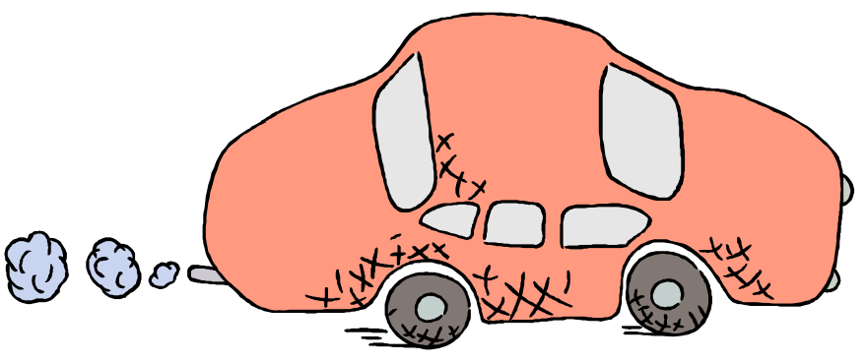
Natural: forest fires, pollen, dust storm
Unnatural: man-made; coal, wood and other fuels used in cars, homes, and factories for energy

Slide 4

How is it measured?

Slide 5

AQI: Air Quality Index
Indicates whether pollutant levels in air may cause health concerns.
Ranges from 0 (least concern) to 500 (greatest concern)

Slide 6
Air Quality | Air Quality Index | Protect Your Health
Good | 0-50 | No health impacts are expected when air quality is in this range.
Moderate | 51-100 | Unusually sensitive people should consider limiting prolonged outdoor exertion.
Unhealthy for Sensitive Groups | 101-150 | Active children and adults, and people with respiratory disease, such as asthma, should limit prolonged outdoor exertion.
Unhealthy | 151-200 | Active children and adults, and people with respiratory disease, such as asthma, should limit prolonged outdoor exertion, everyone else, especially children should limit prolonged outdoor excertion.
Very Unhealthy (Alert) | 201-300 | Active children and adults, and people with respiratory disease, such as asthma, should limit prolonged outdoor exertion everyone else, especially children, should limit outdoor exertion.

Slide 7
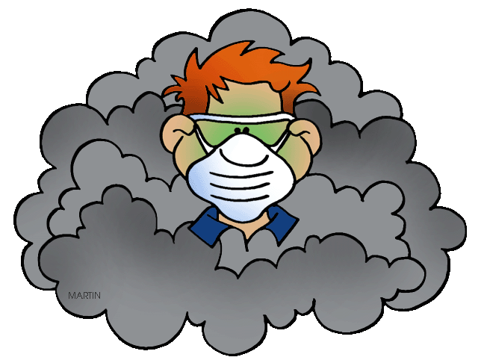
The measured pollutants.....

Slide 8

5 Major Pollutants:
1.) Carbon Monoxide
2.) Sulfur Dioxide
3.) Nitrogen Dioxide
4.) Particulate Matter
5.) Ground Level Ozone

Slide 9

1st smog related deaths were in London in 1873; death toll 500 people; can you imagine how much worse the atmosphere is now?!
Limits visibility
Decreases UV radiation
Yellow/black color over cities
Causes respiratory problems and bronchial related deaths

Slide 10

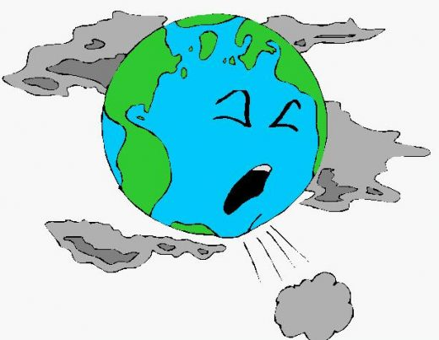

Slide 11



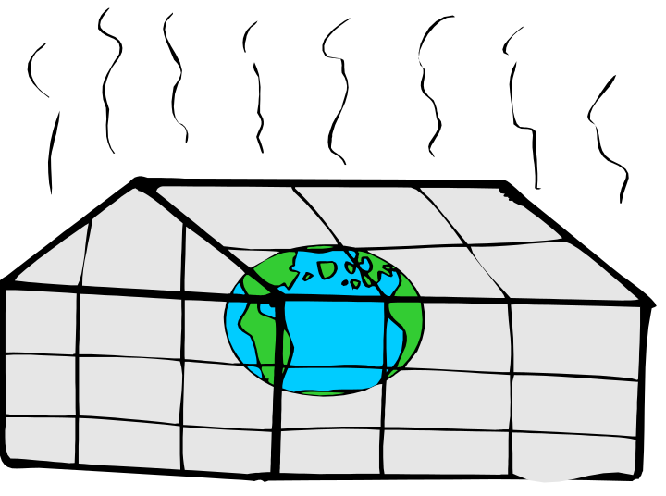

Global Warming
Green House Gases
Thinning Of Ozone Layer
Acid Rain

Slide 12

So, What can YOU do?

Slide 13


Ride your bike
Tell your friends and family about pollution
Make sure your cars get pollution checks
Ride the bus

Slide 14


Learn more; stay up to date
Join a group to stop pollution
Encourage your parents to carpool to work
Switch off lights, fan, heat, etc. when you leave the room

Slide 15


